Slide 1
Understanding the Behavioral Processes Underlying Acceptance and Mindfulness: The Example of Discounting
Thomas J. Waltz
Eastern Michigan University

Slide 2
Discounting

Slide 3
Preference reversals
Relatively small & convenient outcome
Relatively large & inconvenient outcome
VS

Slide 4
Would you rather have…
$500
Immediately
or
$1000 in 1 week
X
$750
Immediately
or
$1000 in 1 week
X
$875
Immediately
or
$1000 in 1 week
X
$985
Immediately
or
$1000 in 1 week
X
$995
Immediately
or
$1000 in 1 week
X

Slide 5
Notes:
Of interest is the points where preference switches from the smaller sooner to the larger later alternative.
The same preference assessment is repeated, but instead of the delay for the full $1000 being one week, it switches…

Slide 6
Would you rather have…
$500
Immediately
or
$1000 in 1 year
X
$750
Immediately
or
$1000 in 1 year
X
X
$875
Immediately
or
$1000 in 1 year
X
$813
Immediately
or
$1000 in 1 year
$781
Immediately
or
$1000 in 1 year
X

Slide 8
Notes:
This process is usually repeated until you have 5 or more delay values assessed

Slide 10
Actual Value
Value where preference reverses
Notes:
Unlike standard assessments that provide a total impulsivity score, discounting curves can be characterized by a single number representing how steep the discounting curve is. The question then becomes, is the steepness of the curve clinically meaningful.

Slide 11
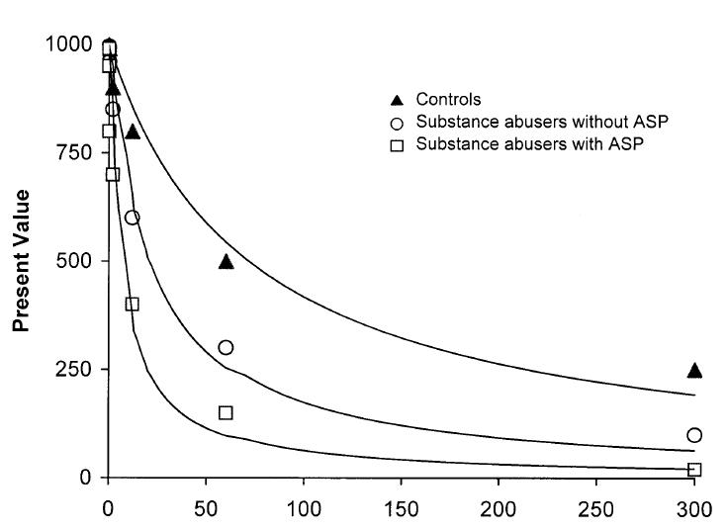
Petry (2002)
Notes:
Delay discounting of $1000 by three groups
This study by Petry illustrates several typical findings from the delay discounting literature
Control subjects have more shallow curves than substance abuser…thus controls held out for larger amounts of money at longer delays.
Individuals with antisocial personality disorder have steeper discounting curves than those who do not. Several other studies have indicated that folks scoring higher on depression, social anxiety, SMI, most substances of abuse (especially nicotine, much less so for MJ)
Individuals with substance abuse and psychological problems have steeper curves than individuals with only substance abuse problems.
Substance abusers used either alcohol (3x/week), cocaine (2x/week), or heroin (daily)
Non-substance-using individuals were asked to participate if they reported no history of substance abuse (no lifetime use of illicit drugs, no lifetime regular use of alcohol, and no more than 3 days of alcohol use in the past 30 days with no more than two drinks per drinking day)

Slide 12
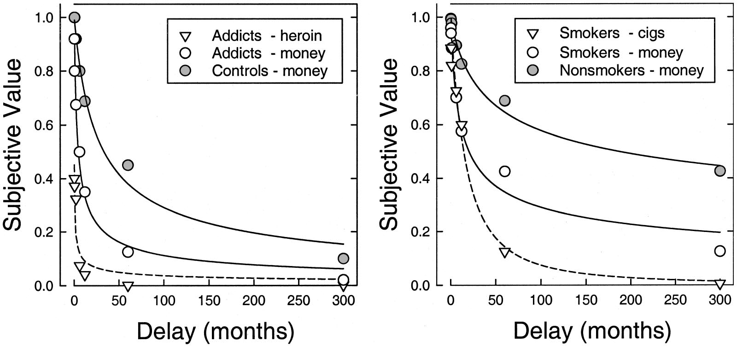
Different Rates for Different Folks & S^{r}s
Notes:
Graphs lifted from Green & Myerson’s 2004 review paper
Both $1000
Left (Madden, Petry, Badger, & Bickel, 1997)
Right (Bickel, Odum, & Madden, 1999)
The grey circles were the non-drug using controls.
Controls discounted less (were less impulsive) than heroin addicts and current smokers.
Heroin and nicotine addicts both discount their drugs more than money. Generally, research has shown that consumable reinforcers are discounted more than nonconsumables.

Slide 13
Relationship to Psychopathology
A defining characteristic of:
ADD/ADHD
Schizophrenia
Mood disorders
Situationally predisposed anxiety disorders
Conduct disorders
Substance abuse
Eating disorders
Habit disorders
Theoretical models:
Addiction
Anxiety
Depression
Suicidal behavior
Borderline personality disorder
Antisocial personality disorder
Experiential avoidance
Psychopathology

Slide 14
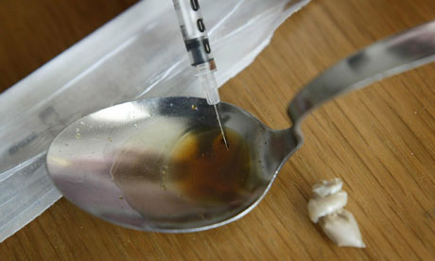
Discounting Various Outcomes
Notes:
Researchers have investigated discounting with a variety of different outcomes
Those of you familiar with the literature will recognize most of these.
It’s important to note that although monetary gains and losses are by far the most common outcomes used in human discounting research, many more outcomes have been used.

Slide 15
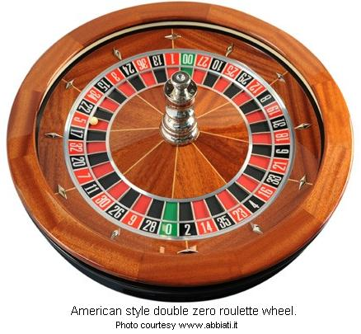
Discounting Inconvenience Variables
Notes:
Several inconveniences have also been investigated as the discounting variable.
These include delay, risk, effort, and social distance.

Slide 16
Acceptance, Defusion, Mindfulness
Relatively small & convenient outcome
Relatively large & inconvenient outcome
VS
Convenience
Immediate
Certain
Low effort
Historically favorable

Slide 17
Acceptance
“Managing” immediate experience
Acting consistent with values in presence of discomfort
VS
Relatively small & convenient outcome
Relatively large & inconvenient outcome
VS

Slide 18
Defusion
Literal &/or immediate stimulus functions of language
Broader, nonliteral orientation to languaging
(delay; S^{D}/S∆)
VS
Relatively small & convenient outcome
Relatively large & inconvenient outcome
VS

Slide 19
Mindfulness
Reacting to attention narrowing contingencies
Attending to the broader context of current action
(selective multiple control)
VS
Relatively small & convenient outcome
Relatively large & inconvenient outcome
VS
Notes:
Immediately as well as reacting to language bringing our history or projected future into the present

Slide 20
Discounting & the AAQ-2
Discounting: steeper curves for several clinical populations—most studied in substance abuse
AAQ-2: higher scores associated with many forms of psychological distress
Negative reinforcement-based coping with immediate aversive experiences
Following data uses non-treatment seeking college student volunteers

Slide 21
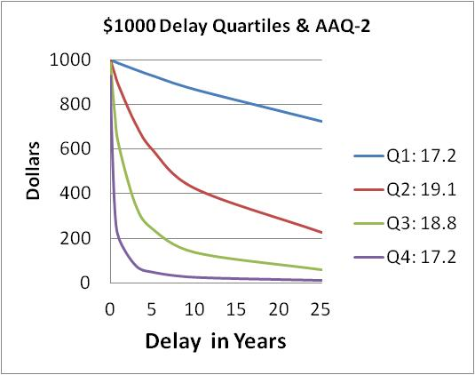
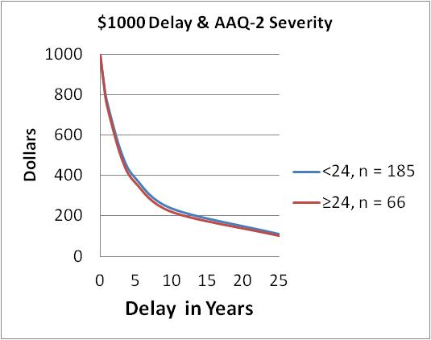
$1000 Delay Discounting

Slide 22
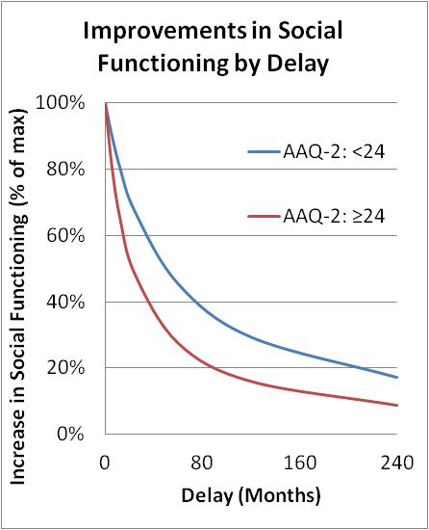
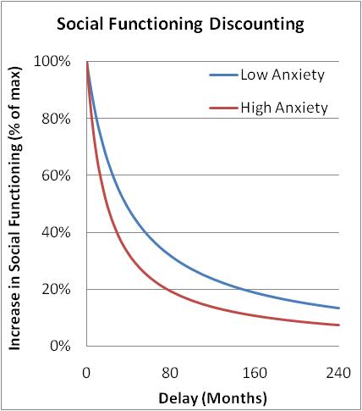

Slide 23
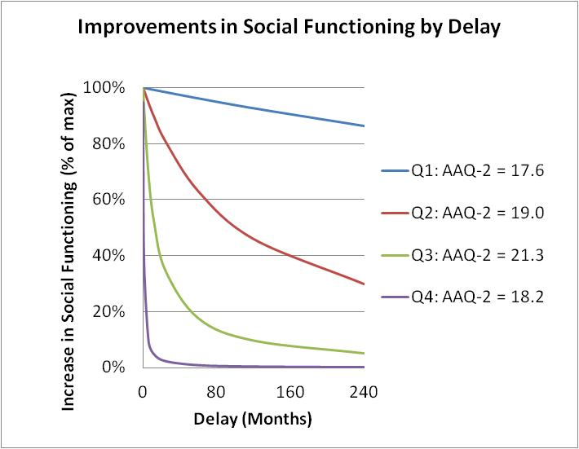

Slide 24
Conclusion
Discounting fits neatly with a contextual behavioral account of clinical presentations
Non-clinical (college) samples produce a wide range of curves, but these do not reliably relate to the AAQ-2
Clinical content specific discounting assessments hold promise of having greater clinical relevance than monetary discounting

